Slide 1
Predictive Analysis of feasibility for phone campaigns by banks and past relevant factors
BY:
Raymond Leong

Slide 2
agenda
Introduction
Business and Data Understanding – We are looking at what we can improve on for the success of future phone campaigns for bank subscriptions to financial institutions
Modeling- Random Forest modeling helps us predict the most important features
Modeling Continued-Success rate & Probabilities
Results & Evaluation- looking at the important features
End
Recommendations- What other models can we use to help identify trends in the data?
Next Steps

Slide 3
Introduction
There are many ways for banks to gain capital, by selling their products to customers through
Varying methods of campaigning yield different results
What is the success rate of a telemarketing campaign?
Demographics of a customer, campaign characteristics, external economic variables are used to predict the success of selling a bank product in this analysis

Slide 4
Business problem
Although we know banking institutions seek to acquire more capital, the major question is: can we sell bank products through the phone?
Through campaigns, investment is required
Unfortunately, we do not have the investment nor capital gain values associated with the study to determine if the campaign was a success
We can artificially determine it
We can determine important variables related to the campaign

Slide 5
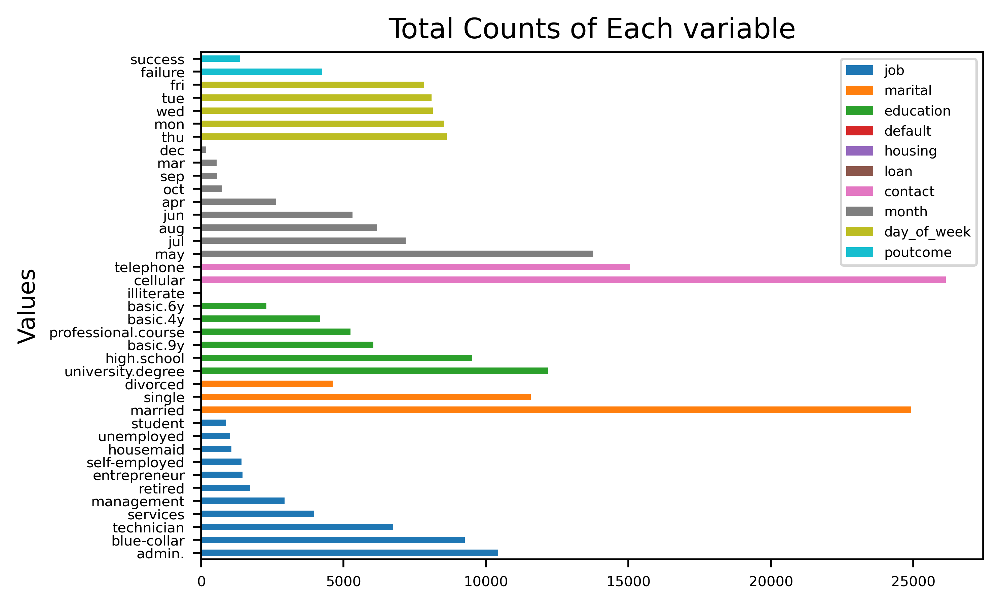
The variables targeted
We see that this past campaign hit a target population that usually
had more cellular conversation over landline
the person called was a university educated person and married
they also were in an administrative position
they were reached mostly in May in the previous campaign

Slide 6
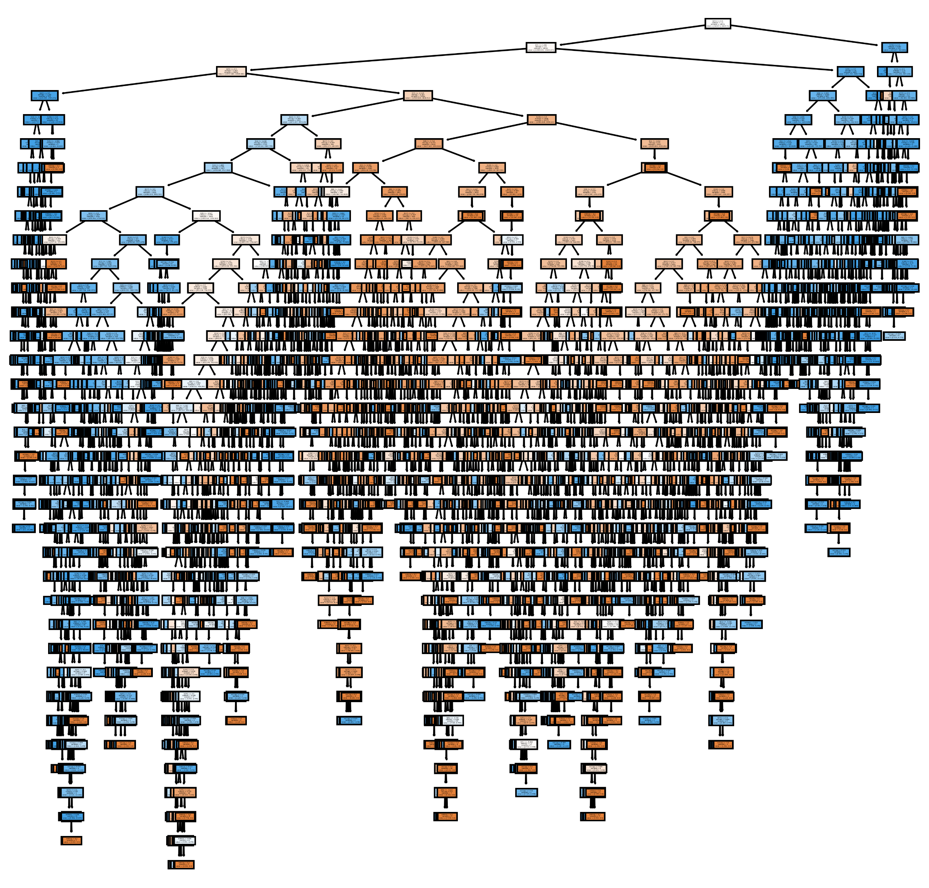
Modeling
Using RF as our model, we were able to find that the most impactful feature was the interest rate at which EU banks lend each other
The accuracy of the mode is 88%, which means that it can predict the right results 88% of the time (if a future customer will subscribe)
Predicts whether a customer will subscribe
Tells us what factors we can focus on to improve the chances of subscription

Slide 7
Results of modelling
Expected chance of making a successful phone call 16.14%
Chance that those calls are lucky 46.76%
Percentage of failed phone calls 83.85%
Percentage of sales you would miss by accident 4.44%

Slide 8
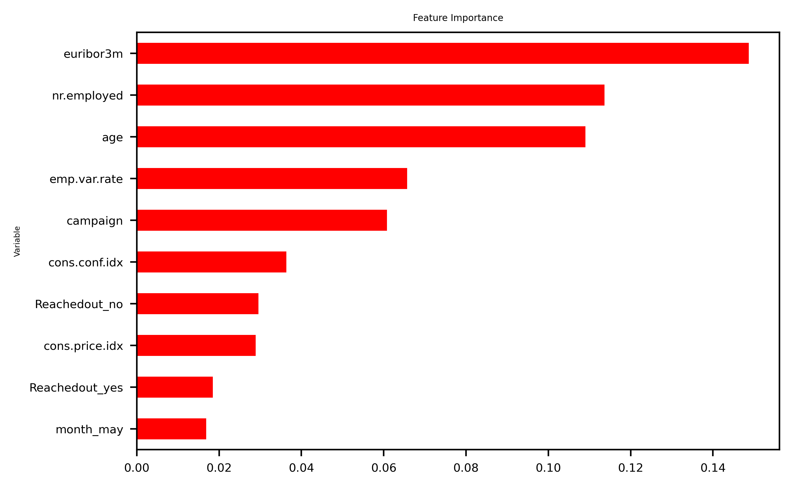
Evaluation: Features to improve on
The original identified variables make an impact
Reaching out to Customers may be a positive or negative indicator of campaign success. However customer perception is more important.
Age is a very important variable in determining if they will either subscribe or not subscribe. There is a certain population that your calls work on and we need to find those clusters.
The amount of times you contact a customer impacts the outcome
Using RF as our model, we were able to find that the most impactful feature was the interest rate at which EU banks lend each other

Slide 9
Recommendations
There exist a need to identify some trends within the data:
There is a certain age group that your calls work on and we need to find those clusters.
The amount of times you contact a customer impacts the outcome, what is the ideal range?
Using the subscriptions missed unintentionally, we should investigate further on what variables they had in common

Slide 10
Conclusion & Next steps
Since communication through phone is not impactful in selling the product, is there another method?
Are there other variables we haven’t considered unique to the Portuguese culture when these phone calls were conducted? (including the cost of the subscription)
A successful campaign determines on the interest rate in which the banks lend each other- further modeling would be needed to identify the proper numbers

Slide 11
Thank you!
Github: www.github/https://github.com/RaymondLeong94
Linkedin: https://www.linkedin.com/in/raymond-leong-b75b11231/

